Slide 1
Chapter 5
The Relational Data Model and Relational Database Constraints

Slide 2
Chapter Outline
Relational Model Concepts
Relational Model Constraints and Relational Database Schemas
Update Operations and Dealing with Constraint Violations
Mapping ER to Relational Schemas
Slide 5- <number>

Slide 3
Relational Model Concepts
Slide 5- <number>

Slide 4
Relational Model Concepts
The model was first proposed by Dr. E.F. Codd of IBM Research in 1970 in the following paper:
  "A Relational Model for Large Shared Data Banks," Communications of the ACM, June 1970
The above paper caused a major revolution in the field of database management and granted Dr. Codd the ACM Turing Award
Slide 5- <number>

Slide 5
Relational Model Concepts
The relational Model of Data is based on the concept of a Relation.
  A Relation is a mathematical concept based on the ideas of sets.
  The strength of the relational approach to data management comes from the formal foundation provided by the theory of relations
The relational model represents the database as a collection of relations.
Informally, each relation resembles a table of values or, to some extent, a flat file of records.
Slide 5- <number>

Slide 6
Informal Definitions
Informally, a relation looks like a table of values.
A relation typically contains a set of rows.
The data elements in each row represent certain facts that correspond to a real-world entity or relationship
  In the formal model, rows are called tuples
Each column has a column header that gives an indication of the meaning of the data items in that column
  In the formal model, the column header is called an attribute name (or just attribute)
Slide 5- <number>

Slide 7

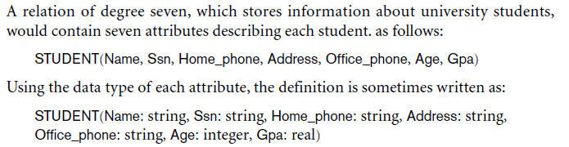
Example of a Relation
Slide 5- <number>

Slide 8
Informal Definitions
Key of a Relation:
  Each row has a value of a data item (or set of items) that uniquely identifies that row in the table
    Called the key
  In the STUDENT table, SSN is the key
  Sometimes row-ids or sequential numbers are assigned as keys to identify the rows in a table
    Called artificial key or surrogate key
Slide 5- <number>

Slide 9
Formal Definitions - Schema
The Schema (or description) of a Relation:
  Denoted by R(A1, A2, .....An)
  R is the name of the relation
  The attributes of the relation are A1, A2, ..., An
Example:
CUSTOMER (Cust-id, Cust-name, Address, Phone#)
  CUSTOMER is the relation name
  Defined over the four attributes: Cust-id, Cust-name, Address, Phone#
Each attribute has a domain or a set of valid values.
  For example, the domain of Cust-id is 6 digit numbers.
  A domain is given a name, data type, and format.
Slide 5- <number>

Slide 10
Formal Definitions - Tuple
Definition:
A tuple is an ordered set of values (enclosed in angle brackets ‘< … >’)
Each value is derived from an appropriate domain.
A row in the CUSTOMER relation is a 4-tuple and would consist of four values, for example:
  <632895, "John Smith", "101 Main St. Atlanta, GA 30332", "(404) 894-2000">
  This is called a 4-tuple as it has 4 values
  A tuple (row) in the CUSTOMER relation.
Definition:
A relation is a set of tuples (rows).
Slide 5- <number>

Slide 11
Formal Definitions - Domain
A domain has a logical definition:
  Example: “USA_phone_numbers” are the set of 10 digit phone numbers valid in the U.S.
A domain also has a data-type or a format defined for it.
  The USA_phone_numbers may have a format: (ddd)ddd-dddd where each d is a decimal digit.
  Dates have various formats such as year, month, date formatted as yyyy-mm-dd, or as dd mm,yyyy etc.
The attribute name designates the role played by a domain in a relation:
  Used to interpret the meaning of the data elements corresponding to that attribute
  Example: The domain Date may be used to define two attributes named “Invoice-date” and “Payment-date” with different meanings
Slide 5- <number>

Slide 12
Formal Definitions - State
The relation state is a subset of the Cartesian product of the domains of its attributes
  each domain contains the set of all possible values the attribute can take.
Example: attribute Cust-name is defined over the domain of character strings of maximum length 25
  dom(Cust-name) is varchar(25)
The role these strings play in the CUSTOMER relation is that of the name of a customer.
Slide 5- <number>

Slide 13
Formal Definitions - Summary
Formally,
  Given R(A1, A2, .........., An)
  r(R) ⊂ dom (A1) X dom (A2) X ....X dom(An)
R(A1, A2, …, An) is the schema of the relation
R is the name of the relation
A1, A2, …, An are the attributes of the relation
r(R): a specific state (or "value" or “population”) of relation R – this is a set of tuples (rows)
  r(R) = {t1, t2, …, tn} where each ti is an n-tuple
  ti = <v1, v2, …, vn> where each vj element-of dom(Aj)
Slide 5- <number>

Slide 14
Formal Definitions - Example
Let R(A1, A2) be a relation schema:
  Let dom(A1) = {0,1}
  Let dom(A2) = {a,b,c}
Then: dom(A1) X dom(A2) is all possible combinations:
  {<0,a> , <0,b> , <0,c>, <1,a>, <1,b>, <1,c> }
The relation state r(R) ⊂ dom(A1) X dom(A2)
For example: r(R) could be {<0,a> , <0,b> , <1,c> }
  this is one possible state (or “population” or “extension”) r of the relation R, defined over A1 and A2.
  It has three 2-tuples: <0,a> , <0,b> , <1,c>
Slide 5- <number>

Slide 15
Definition Summary
Informal Terms |  | Formal Terms
Table |  | Relation
Column Header |  | Attribute
All possible Column Values |  | Domain
Row |  | Tuple
Table Definition |  | Schema of a Relation
Populated Table |  | State of the Relation
Slide 5- <number>

Slide 16
Characteristics of Relations
Slide 5- <number>
Notes:
Section 2

Slide 17
Characteristics Of Relations
Ordering of tuples in a relation r(R):
  The tuples are not considered to be ordered, even though they appear to be in the tabular form.
Ordering of attributes in a relation schema R (and of values within each tuple):
  We will consider the attributes in R(A1, A2, ..., An) and the values in t=<v1, v2, ..., vn> to be ordered .
    (However, a more general alternative definition of relation does not require this ordering).
Slide 5- <number>

Slide 18
Example – A relation STUDENT
Slide 5- <number>

Slide 19

Same state as previous Figure (but with different order of tuples)
Slide 5- <number>

Slide 20
Characteristics Of Relations
Values in a tuple:
  All values are considered atomic (indivisible).
  Each value in a tuple must be from the domain of the attribute for that column
    If tuple t = <v1, v2, …, vn> is a tuple (row) in the relation state r of R(A1, A2, …, An)
    Then each vi must be a value from dom(Ai)
  A special null value is used to represent values that are unknown or inapplicable to certain tuples.
Slide 5- <number>

Slide 21
Characteristics Of Relations
Notation:
  We refer to component values of a tuple t by:
    t[Ai] or t.Ai
    This is the value vi of attribute Ai for tuple t
  Similarly, t[Au, Av, ..., Aw] refers to the subtuple of t containing the values of attributes Au, Av, ..., Aw, respectively in t
Slide 5- <number>

Slide 22
Relational Integrity Constraints
Slide 5- <number>

Slide 23
Relational Integrity Constraints
Constraints are conditions that must hold on all valid relation states.
There are three main types of constraints in the relational model:
  (1) Key constraints
  (2) Entity integrity constraints
  (3) Referential integrity constraints
Another implicit constraint is the domain constraint
  Every value in a tuple must be from the domain of its attribute (or it could be null, if allowed for that attribute)
Slide 5- <number>

Slide 24
(1) Key Constraints
Superkey of R:
  Is a set of attributes SK of R with the following condition:
    No two tuples in any valid relation state r(R) will have the same value for SK
    That is, for any distinct tuples t1 and t2 in r(R), t1[SK] ≠ t2[SK]
    This condition must hold in any valid state r(R)
Key of R:
  A "minimal" superkey
  That is, a key is a superkey K such that removal of any attribute from K results in a set of attributes that is not a superkey (does not possess the superkey uniqueness property)
Slide 5- <number>

Slide 25
Key Constraints (continued)
Example: Consider the CAR relation schema:
  CAR(State, Reg#, SerialNo, Make, Model, Year)
  CAR has two keys:
    Key1 = {State, Reg#}
    Key2 = {SerialNo}
  Both are also superkeys of CAR
  {SerialNo, Make} is a superkey but not a key.
In general:
  Any key is a superkey (but not vice versa)
  Any set of attributes that includes a key is a superkey
  A minimal superkey is also a key
Slide 5- <number>

Slide 26
Key Constraints (continued)
If a relation has several candidate keys, one is chosen arbitrarily to be the primary key.
  The primary key attributes are underlined.
Example: Consider the CAR relation schema:
  CAR(State, Reg#, SerialNo, Make, Model, Year)
  We chose SerialNo as the primary key
The primary key value is used to uniquely identify each tuple in a relation
  Provides the tuple identity
Also used to reference the tuple from another tuple
  General rule: Choose as primary key the smallest of the candidate keys (in terms of size)
  Not always applicable – choice is sometimes subjective
Slide 5- <number>

Slide 27

CAR table with two candidate keys – LicenseNumber chosen as Primary Key
Slide 5- <number>

Slide 28
Relational Database Schema
Relational Database Schema:
  A set S of relation schemas that belong to the same database.
  S is the name of the whole database schema
  S = {R1, R2, ..., Rn}
  R1, R2, …, Rn are the names of the individual relation schemas within the database S
Example:
COMPANY = {EMPLOYEE, DEPARTMENT, DEPT_LOCATIONS,
PROJECT, WORKS_ON, DEPENDENT}.
Following slide shows a COMPANY database schema with 6 relation schemas.
Slide 5- <number>

Slide 29

The COMPANY Database Relational Schema
Note: We got this schema by Mapping the ER schema of Figure 3.2 to this Relational Schema. To know how wait for the next section of this chapter.
Slide 5- <number>

Slide 30
(2) Entity Integrity Constraint
The Entity Integrity constraints states that:
The primary key attributes PK of each relation schema R in S cannot have null values in any tuple of r(R).
    This is because primary key values are used to identify the individual tuples.
    t[PK] ≠ null for any tuple t in r(R)
    If PK has several attributes, null is not allowed in any of these attributes
  Note: Other attributes of R may be constrained to disallow null values, even though they are not members of the primary key.
Slide 5- <number>

Slide 31
(3) Referential Integrity
The referential integrity constraint is specified between two relations and is used to maintain the consistency among tuples in the two relations (i.e,. Used to specify a relationship among tuples in two relations):
  The referencing relation and the referenced relation.
Tuples in the referencing relation R1 have attributes FK (called foreign key attributes) that reference the primary key attributes PK of the referenced relation R2.
  A tuple t1 in R1 is said to reference a tuple t2 in R2 if t1[FK] = t2[PK].
Informally, the referential integrity constraint states that a tuple in one relation that refers to another relation must refer to an existing tuple in that relation.
Slide 5- <number>

Slide 32
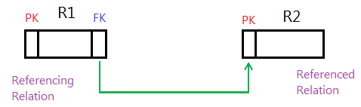
Referential Integrity
A referential integrity constraint can be displayed in a relational database schema as a directed arc from
R1.FK to R2.
  Note: In a database of many relations, there are usually many referential integrity constraints.
Slide 5- <number>

Slide 33
Referential Integrity (or foreign key)
Constraint
Statement of the constraint
  The value in the foreign key column (or columns) FK of the the referencing relation R1 can be either:
    (1) a value of an existing primary key value of a corresponding primary key PK in the referenced relation R2, or
    (2) a null.
In case (2), the FK in R1 should not be a part of its own primary key.
Slide 5- <number>

Slide 34
Displaying a relational database schema and its constraints
Each relation schema can be displayed as a row of attribute names
The name of the relation is written above the attribute names
The primary key attribute (or attributes) will be underlined
A foreign key (referential integrity) constraints is displayed as a directed arc (arrow) from the foreign key attributes to the referenced table
  Can also point the the primary key of the referenced relation for clarity
Next slide shows the COMPANY relational schema diagram
Slide 5- <number>

Slide 35

Referential Integrity Constraints for COMPANY database
Slide 5- <number>

Slide 36
Other Types of Constraints
Semantic Integrity Constraints:
  based on application semantics and cannot be expressed by the model per se
  Example: “the max. no. of hours per employee for all projects he or she works on is 56 hrs per week”
A constraint specification language may have to be used to express these
SQL-99 allows triggers and ASSERTIONS to express for some of these
Slide 5- <number>
Notes:
Section 2

Slide 37
Operations on Database
Slide 5- <number>

Slide 38
Populated database state
Each relation will have many tuples in its current relation state
The relational database state is a union of all the individual relation states
Whenever the database is changed, a new state arises
Basic operations for changing the database:
  INSERT a new tuple in a relation
  DELETE an existing tuple from a relation
  MODIFY an attribute of an existing tuple
Next slide shows an example state for the COMPANY database
Slide 5- <number>

Slide 39

Populated database state for COMPANY
Slide 5- <number>

Slide 40
Update Operations on Relations
INSERT a tuple.
DELETE a tuple.
MODIFY a tuple.
Integrity constraints should not be violated by the update operations.
Several update operations may have to be grouped together.
Updates may propagate to cause other updates automatically. This may be necessary to maintain integrity constraints.
Slide 5- <number>

Slide 41
Update Operations on Relations
In case of integrity violation, several actions can be taken:
  Cancel the operation that causes the violation (RESTRICT or REJECT option)
  Perform the operation but inform the user of the violation
  Trigger additional updates so the violation is corrected (CASCADE option, SET NULL option)
  Execute a user-specified error-correction routine
Slide 5- <number>

Slide 42
Possible violations for each operation
The INSERT Operation may violate any of the constraints:
  Domain constraint:
    if one of the attribute values provided for the new tuple is not of the specified attribute domain
  Key constraint:
    if the value of a key attribute in the new tuple already exists in another tuple in the relation
  Referential integrity:
    if a foreign key value in the new tuple references a primary key value that does not exist in the referenced relation
  Entity integrity:
    if the primary key value is null in the new tuple
Slide 5- <number>

Slide 43
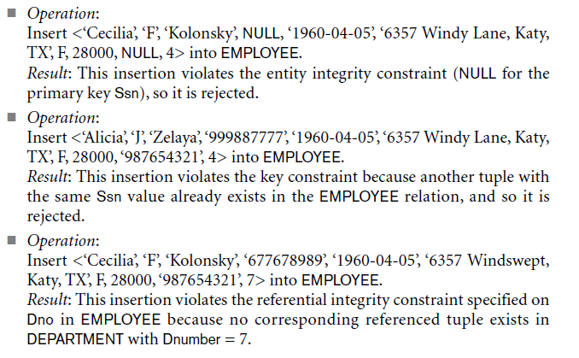
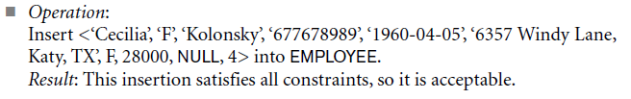
INSERT
Slide 5- <number>

Slide 44
Possible violations for each operation
DELETE may violate only referential integrity:
  If the primary key value of the tuple being deleted is referenced from other tuples in the database
    Can be remedied by several actions: RESTRICT, CASCADE, SET NULL (see Chapter 8 for more details)
      RESTRICT option: reject the deletion
      CASCADE option: propagate the new primary key value into the foreign keys of the referencing tuples
      SET NULL option: set the foreign keys of the referencing tuples to NULL
  One of the above options must be specified during database design for each foreign key constraint
Slide 5- <number>

Slide 45
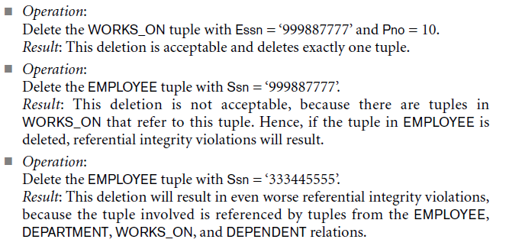
DELETE
Slide 5- <number>

Slide 46
Possible violations for each operation
UPDATE may violate domain constraint and NOT NULL constraint on an attribute being modified
Any of the other constraints may also be violated, depending on the attribute being updated:
  Updating the primary key (PK):
    Similar to a DELETE followed by an INSERT
    Need to specify similar options to DELETE
  Updating a foreign key (FK):
    May violate referential integrity
  Updating an ordinary attribute (neither PK nor FK):
    Can only violate domain constraints
Slide 5- <number>

Slide 47
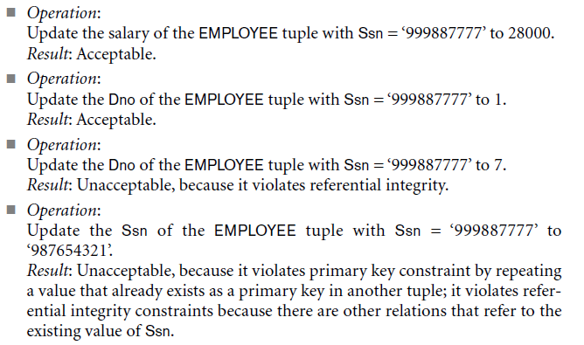
UPDATE
Slide 5- <number>

Slide 48
The Transaction Concept
A database application program running against a relational database typically executes one or more transactions.
A transaction is an executing program that includes some database operations, such as reading from the database, or applying insertions, deletions, or updates to the database.
At the end of the transaction, it must leave the database in a valid or consistent state that satisfies all the constraints specified on the database schema.
A single transaction may involve any number of retrieval operations and any number of update operations. These retrievals and updates will together form an atomic unit of work against the database.
For example, a transaction to apply a bank withdrawal will typically read the user account record, check if there is a sufficient balance, and then update the record by the withdrawal amount.
Slide 5- <number>

Slide 49
Exercise
(Taken from Exercise 5.15)
Consider the following relations for a database that keeps track of student enrollment in courses and the books adopted for each course:
STUDENT(SSN, Name, Major, Bdate)
COURSE(Course#, Cname, Dept)
ENROLL(SSN, Course#, Quarter, Grade)
BOOK_ADOPTION(Course#, Quarter, Book_ISBN)
TEXT(Book_ISBN, Book_Title, Publisher, Author)
Draw a relational schema diagram specifying the foreign keys for this schema.
Slide 5- <number>

Slide 50
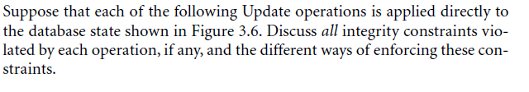
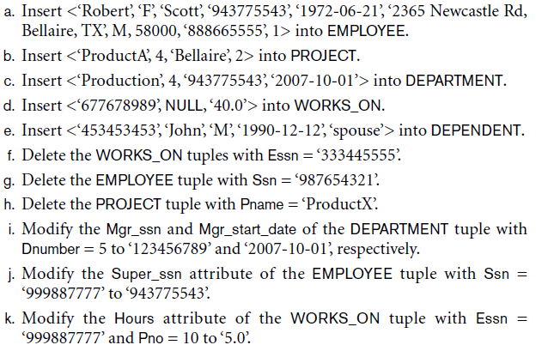
Exercise
Slide 5- <number>

Slide 51
Populated database state for COMPANY
Slide 5- <number>

Slide 52

Slide 5- <number>

